Slide 1
Chapter 5: CPU Scheduling

Slide 2
Chapter 5: CPU Scheduling
Basic Concepts
Scheduling Criteria
Scheduling Algorithms
Thread Scheduling
Multi-Processor Scheduling
Real-Time CPU Scheduling
Operating Systems Examples
Algorithm Evaluation

Slide 3
Objectives
Describe various CPU scheduling algorithms
Assess CPU scheduling algorithms based on scheduling criteria
Explain the issues related to multiprocessor and multicore scheduling
Describe various real-time scheduling algorithms
Describe the scheduling algorithms used in the Windows, Linux, and Solaris operating systems
Apply modeling and simulations to evaluate CPU scheduling algorithms

Slide 4
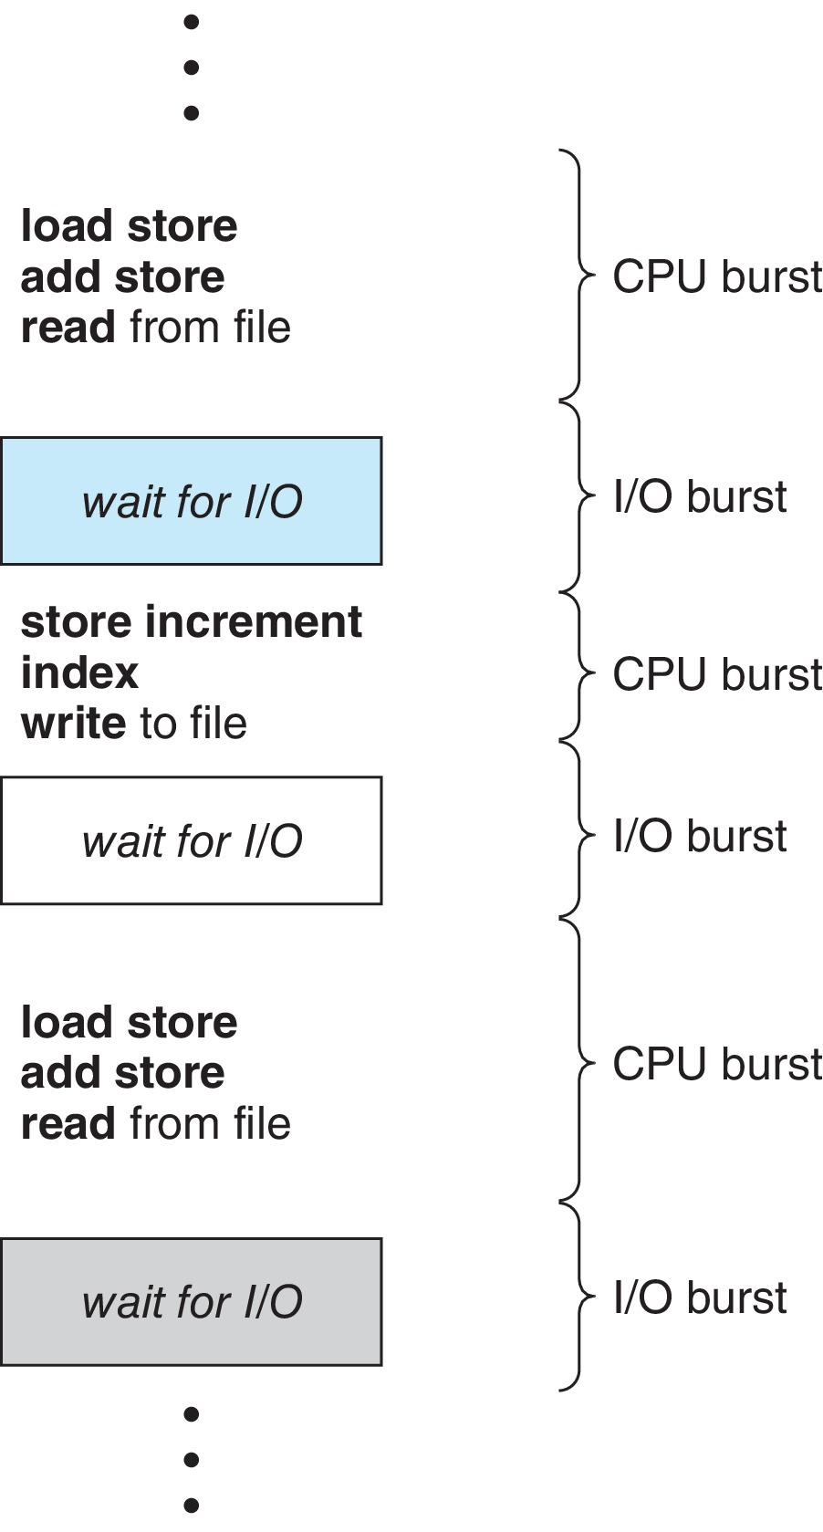
Basic Concepts
Maximum CPU utilization obtained with multiprogramming
CPU – I/O Burst Cycle :: Process execution consists of a cycle of CPU execution and I/O wait
CPU burst followed by I/O burst
CPU burst distribution is of main concern
Notes:
CPU Burst
- It is the amount of time, a process uses the CPU until it starts waiting for some input or interrupted by some other process
- I/O Burst or Input Output burst
- It is the amount of time, a process waits for input-output before needing CPU time.
Burst Cycle
The execution of process consists of a cycle of CPU burst and I/O burst. Usually it starts with CPU burst and then followed by I/O burst, another CPU burst, another I/O burst and so on. This cycle will continue until the process is terminated.
- CPU bound and I/O bound
- In Actual, a Process comprises of CPU bound and I/O bound programs. An I/O bound program has many short CPU bursts. A CPU bound program might have a few long CPU bursts.

Slide 5
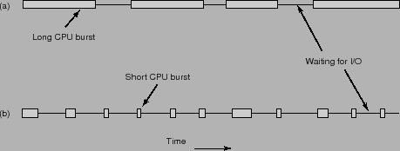
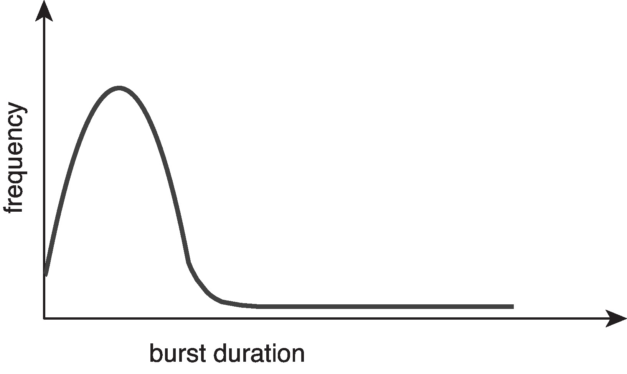
Histogram of CPU-burst Times
Large number of short bursts
Small number of longer bursts
Notes:
- Kaynak : http://boron.physics.metu.edu.tr/ozdogan/OperatingSystems/week5/node19.html

Slide 6
CPU Scheduler
The CPU scheduler selects from among the processes in ready queue, and allocates a CPU core to one of them
  Queue may be ordered in various ways
CPU scheduling decisions may take place when a process:
  1. Switches from running to waiting state
  2. Switches from running to ready state
  3. Switches from waiting to ready
  Terminates
Scheduling under 1 and 4 is nonpreemptive
All other scheduling is preemptive
  Consider access to shared data
  Consider preemption while in kernel mode
  Consider interrupts occurring during crucial OS activities

Slide 7
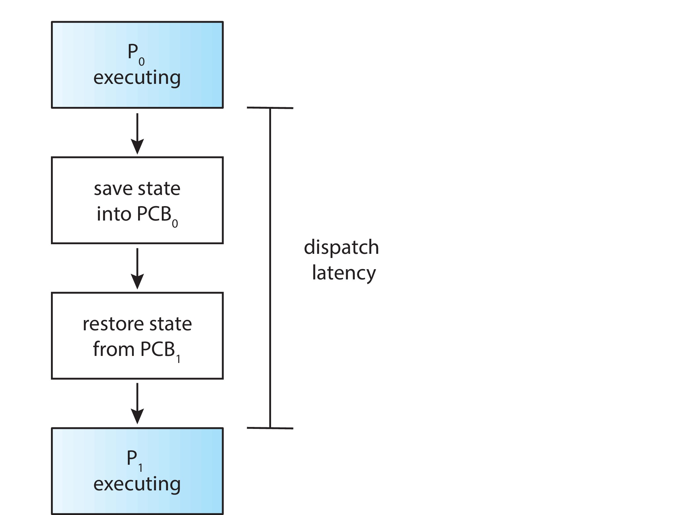
Dispatcher
Dispatcher module gives control of the CPU to the process selected by the short-term scheduler; this involves:
  switching context
  switching to user mode
  jumping to the proper location in the user program to restart that program
Dispatch latency – time it takes for the dispatcher to stop one process and start another running

Slide 8
Scheduling Criteria
CPU utilization – keep the CPU as busy as possible. Ideally the CPU would be busy 100% of the time
Throughput – # of processes that complete their execution per time unit
Turnaround time – amount of time to execute a particular process (Wall clock time)
Waiting time – amount of time a process has been waiting in the ready queue
Response time – amount of time it takes from when a request was submitted until the first response is produced, not output (for time-sharing environment)
Notes:
here are several different criteria to consider when trying to select the "best" scheduling algorithm for a particular situation and environment, including:
CPU utilization - Ideally the CPU would be busy 100% of the time, so as to waste 0 CPU cycles. On a real system CPU usage should range from 40% ( lightly loaded ) to 90% ( heavily loaded. )
Throughput - Number of processes completed per unit time. May range from 10 / second to 1 / hour depending on the specific processes.
Turnaround time - Time required for a particular process to complete, from submission time to completion. ( Wall clock time. )
Waiting time - How much time processes spend in the ready queue waiting their turn to get on the CPU.
( Load average - The average number of processes sitting in the ready queue waiting their turn to get into the CPU. Reported in 1-minute, 5-minute, and 15-minute averages by "uptime" and "who". )
Response time - The time taken in an interactive program from the issuance of a command to the commence of a response to that command.

Slide 9
Scheduling Algorithm Optimization Criteria
Max CPU utilization
Max throughput
Min turnaround time
Min waiting time
Min response time

Slide 10
End of Chapter 5

